Slide 1
Transitions

Slide 2
Transitions
When elements transition from one state to another, you can alter their appearance
If you hover over the link, change the color
If an image comes into focus, change the size,

Slide 3
The Properties
transition-property
What is it you want to change? (size, color, position, etc.)
transition-duration
How long should each transition last?
transition-timing
Should it be a smooth transition (linear)? Or different?
transition-delay
How long should the wait be before the transition begins?

Slide 4
Setting up
Define your element
Choose the elements for transition
Define the new values
You must combine this step with a pseudo-class

Slide 5
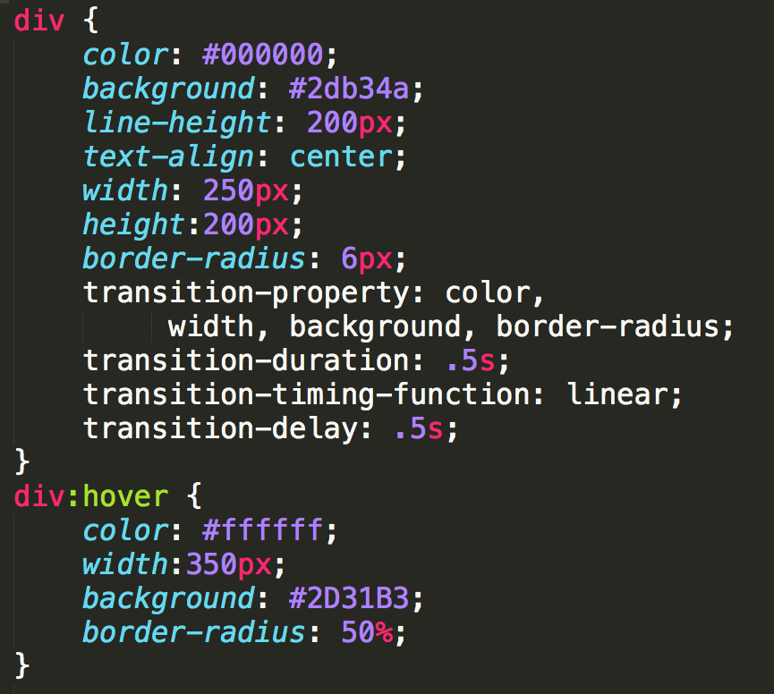
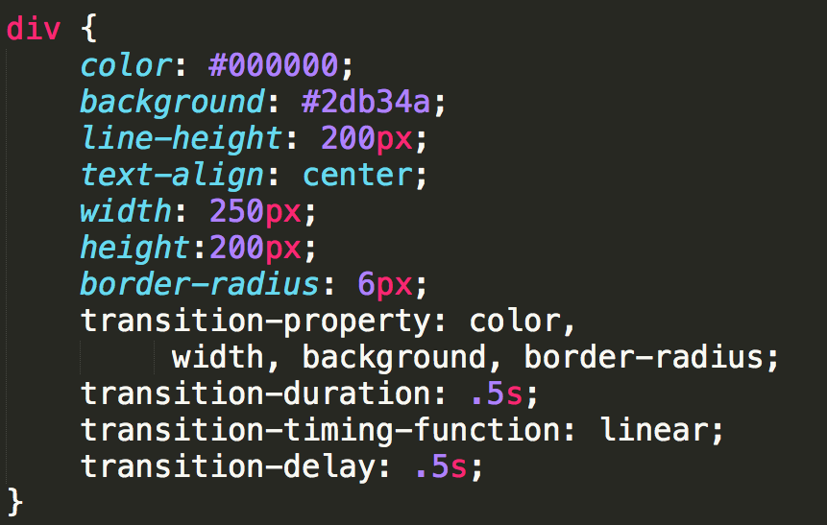
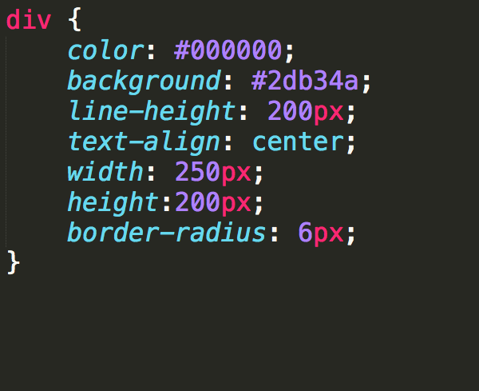
Example (CSS3-transitions)

Slide 6
Using Shorthands
If you have multiple properties transitioning, you can use shorthand:

Slide 7
Review

Slide 8

Acknowledgements/Contributions
These slides are Copyright 2015- Colleen van Lent as part of http://www.intro-webdesign.com/ and made available under a Creative Commons Attribution Non-Commercial 4.0 License. Please maintain this last slide in all copies of the document to comply with the attribution requirements of the license. If you make a change, feel free to add your name and organization to the list of contributors on this page as you republish the materials.
Initial Development: Colleen van Lent , University of Michigan School of Information

